Slide 1
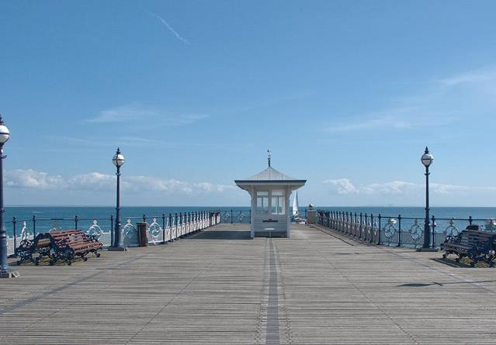
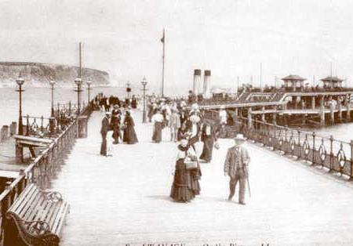
A tale of two piers
Swanage Pier

Slide 2
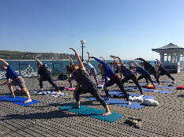
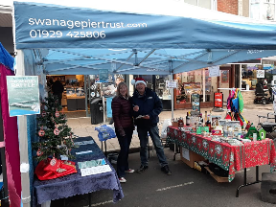
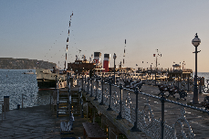
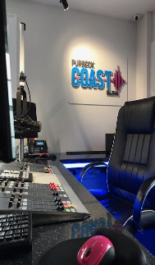
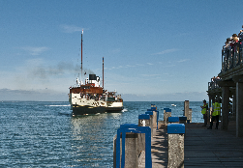
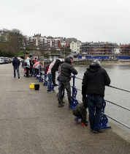
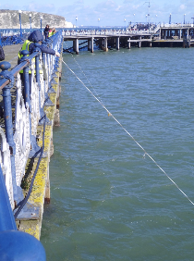
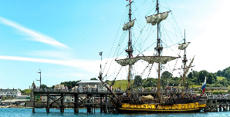
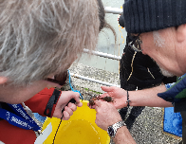
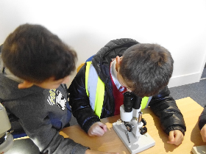
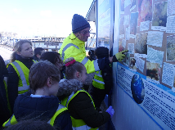
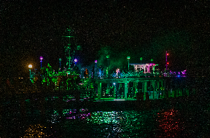
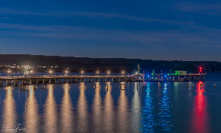
What happens on Swanage pier?
Yoga classes
The Waverly paddle steamer
Christmas market
Purbeck Coast
radio station
Outdoor learning sessions
for schools
Eco crabbing
events
Pirate festival
C
Classroom based learning
sessions for schools
Light up the pier festival

Slide 3
What is our offer to schools?
A wide range of different learning 0ppotunities
Self-led workshops and visits
Online resources: National Curriculam linked lessons and activities to engage with at home or as part of a lesson
In-house National Curriculum linked workshops
Arts and craft activities in school holidays
Year-round community activities and workshops for all ages

Slide 4
Important things you might not know about the pier
1.The Gribble worm lives 'in' parts of the pier
2. It is a marine conservation area
3. The pier is one of the oldest wooden pier in the UK
4. On the pier is the oldest diving school in the UK
5. Our exhibition area hosts a living aquarium
6. The pier was an important part of Swanage as a thriving Victorian seaside town

Slide 5
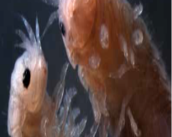
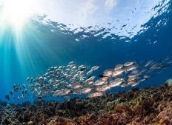
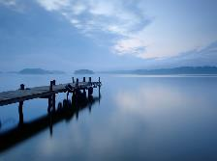
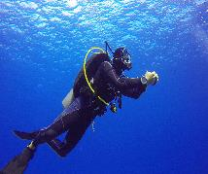
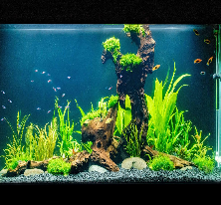
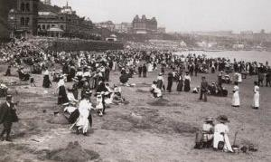
1. The gribble worm
This is not really a worm but a very small wood eating marine crustacean that lives on the wooden piles that hold up the pier.
2. Marine conservation area
The pier is a Marine Protected Area containing a range of different species and habitats. The Purbeck Coast supports a variety of habitats ranging from coarse sediments to rocky areas comprised of rock pools and boulders. These provide homes for stalked jellyfish, sea cucumbers, tube worms and beautiful anemones.
3. One of the oldest wooden piers
Swanage old pier was the first pier in Swanage was erected in 1859 for quarrymen to ferry Purbeck stone. Stone was loaded into vessels off the pier after being hauled by horse-drawn carts on a tramway. The pier’s skeletal remains stretch out into the sea and make up one of the last remaining wooden piers in Britain.
4. Oldest diving school
Swanage pier is a popular dive site being one of the few sheltered sea diving sites on the south coast. Thousands come to Swanage Pier to Scuba Dive under the wooden Pier or board boats to local dive destinations, including many wrecks lying in deeper water outside the bay.
5. Living aquarium
In our aquarium you can see a variety of creatures that have come from around the pier including Lobsters, prawns, crabs and many different species of fish. These are kept in the aquarium for a short time and then released back into the sea.
6. The pier was very important for Swanage in Victorian times
In the 19th century, Swanage enjoyed its reputation as a popular seaside resort with the coming of the railway in 1885. In 1889, the Grand Hotel was built overlooking the bay. Then, in 1897, Swanage's new pier was opened to the public.
1.
2.
3.
4.
5.
6.

Slide 6
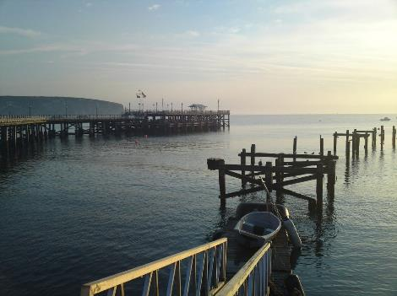
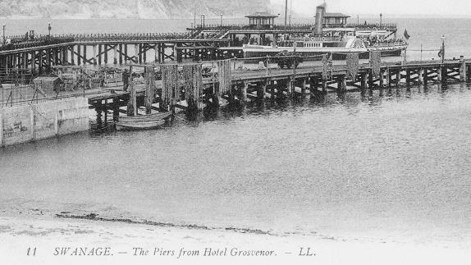
The old pier and the new pier
Then.....
...and now

Slide 7
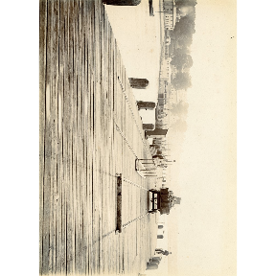
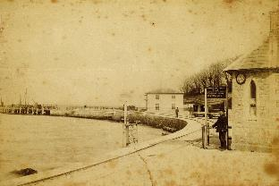
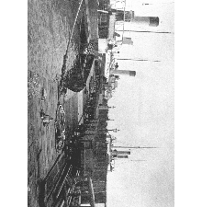
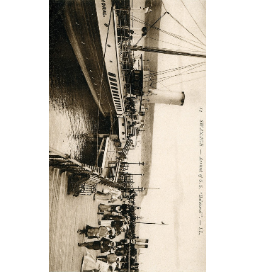
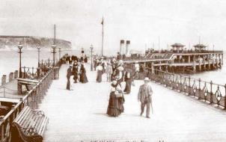
A tale of two piers
The first pier was constructed in1859/60 by James Walton of London for the Swanage Pier and Tramway Company and opened by John Mowlem. The Pier was built primarily for shipping stone.
The new Pier was officially opened on 29th March 1897 as more people and boats were visiting.

Slide 8
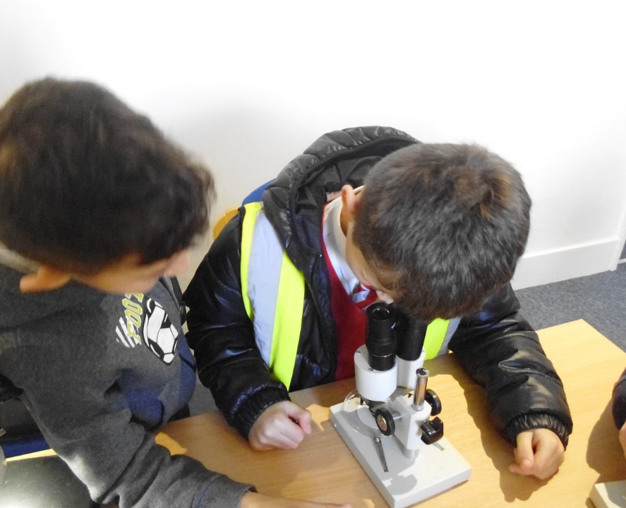
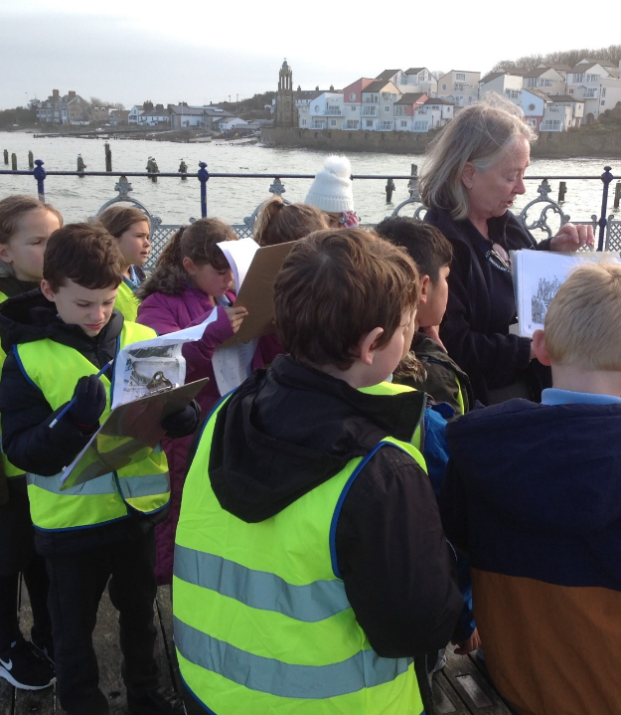
Why might you want to visit the pier?
To take part in interesting and fun outside learning sessions
These include lots of hands-on activities to get involved in
All learning sessions are led by expert volunteers
Using the pier, marine environment and the historical artefacts related to the pier this will make your learning experience much more interesting, interactive and accessible
You will learn about the fascinating history of the pier and how it came to be
We offer seasonal and holiday fun arts and craft activities to engage in

Slide 9
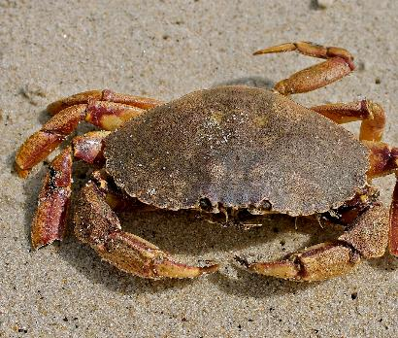
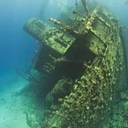
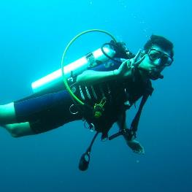
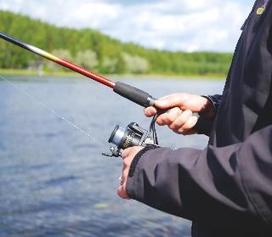

Top 10 things to do when you visit the pier
Have a go at crabbing (we can teach you all about eco crabbing)
Watch the pier film story, ‘A Scintillating Tale’ in our exhibition area and on our website
See the remains of the old bath house under the pier as you have a cuppa and cake in the café downstairs ( in the 1900s??? people would come to Swanage pier for a healthy salt bath, a cup of coffee and to play billiards!)
Discover the interesting and unusual artefacts from the wrecked ship Kyarra in the exhibition area
Follow the pier digital tour (you can access his on your own phone)
What creatures can you spot in the living aquarium?
Learn to dive (Divers Down is the oldest diving school in the UK)
Try angling and see what you can catch from the pier (look at our fishing guidance leaflet)
Go bird watching and see the elegant terns who visit here over the summer, zooming down from up high to catch fish. Try and spot the cormorants bobbing down to dive and then appearing somewhere else! Can you tell the difference between a herring gull and greater black backed gull?
See if you can see where the remains of the old pier lie, how much of it is left?

Slide 10
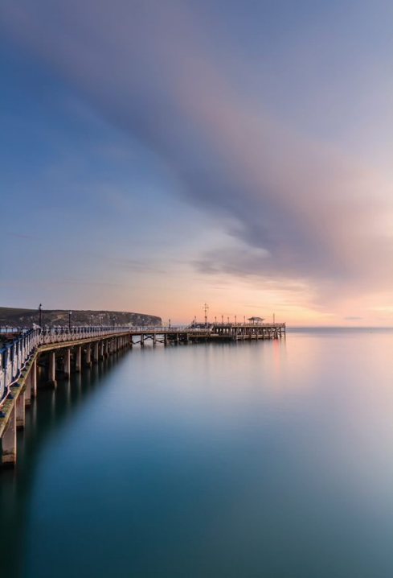
We hope to see you soon!!!
Visit our website and look at the online learning resources we have to offer at: Learning Resources | The Swanage Pier Trust
Book a visit to the pier, this can be for one of our self-let trails or for a walking tour or workshop. To book contact:
Volunteer and events Coordinator: activities@swanagepiertrust.com
Education and Learning Officer: learning@swanagepiertrust.com
If you would like to request a bespoke session please let us know and we can see how we can help.

